Slide 1

Skegby Junior Academy
Forest School

Slide 2
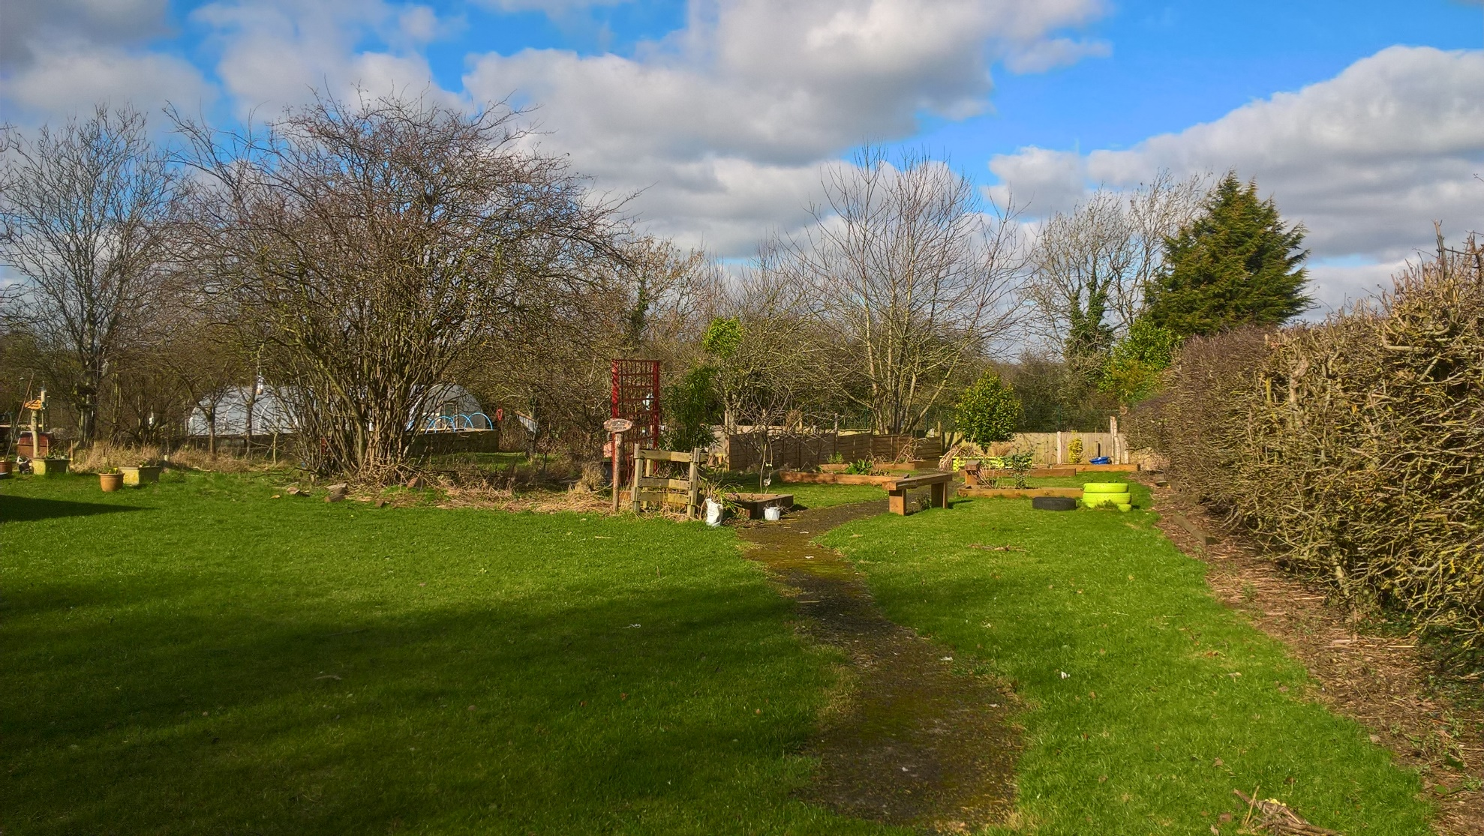

Slide 3
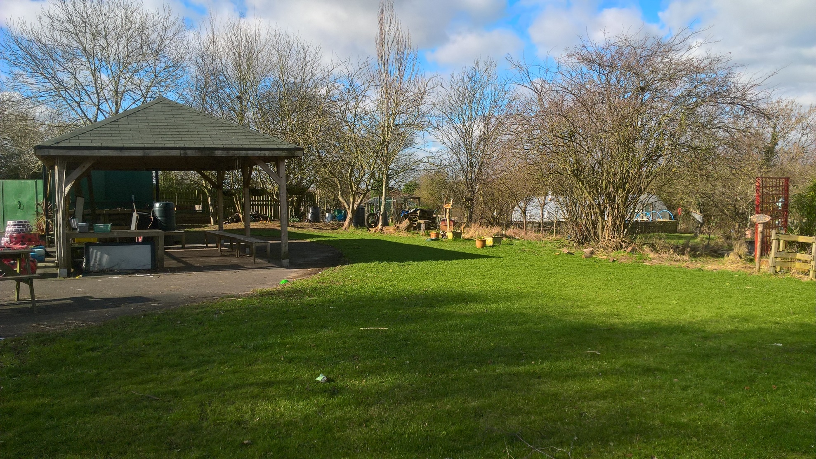

Slide 4
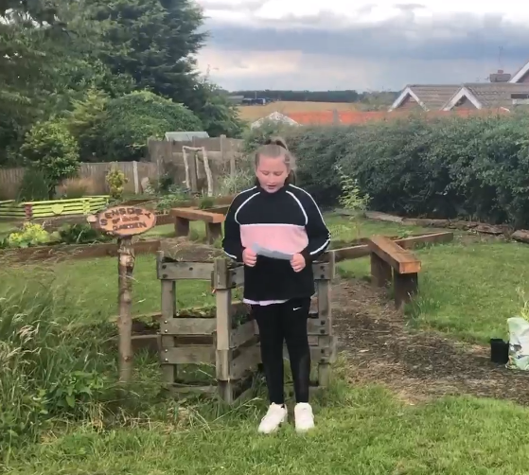
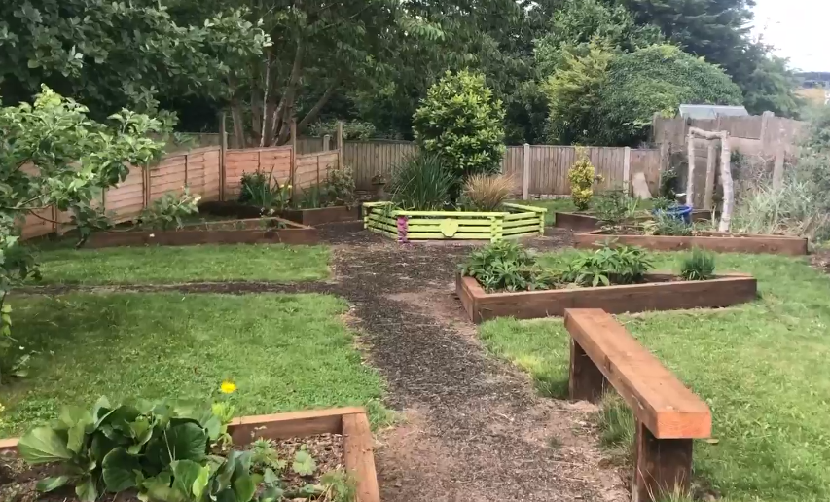

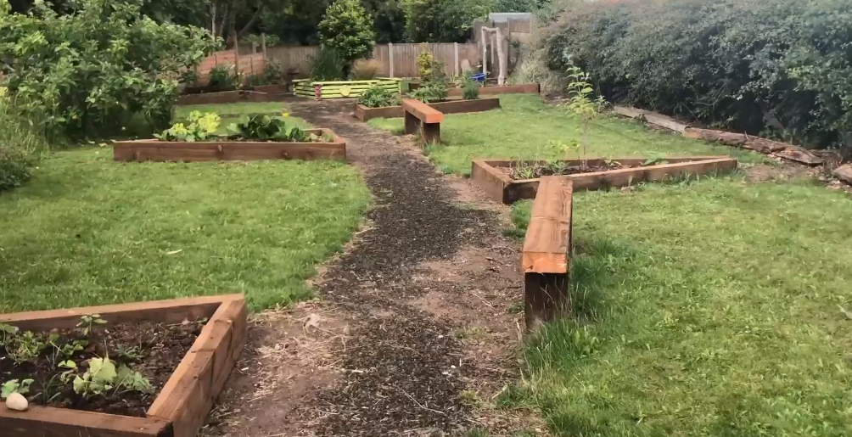
The Sensory Garden
Each class has its own triangular bed to be responsible for looking after.

Slide 5
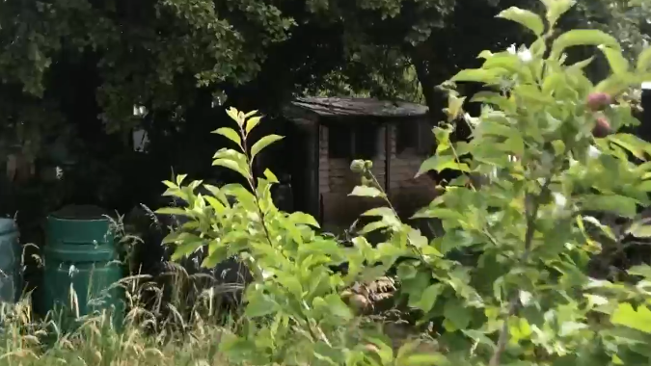
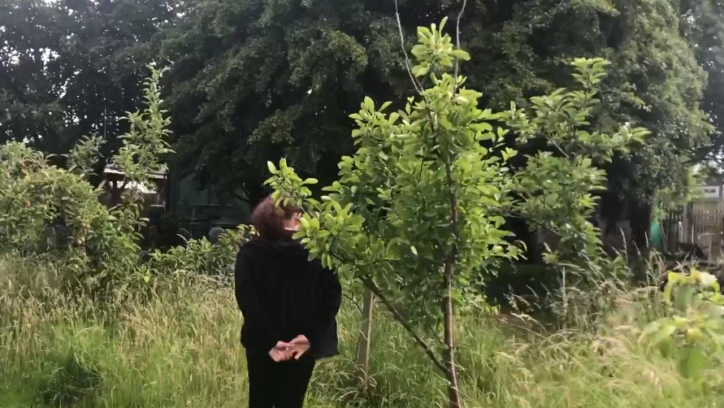
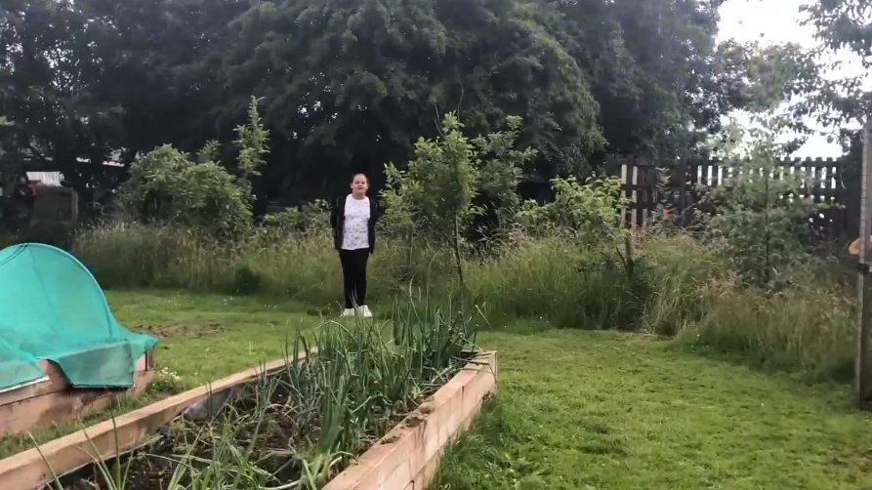
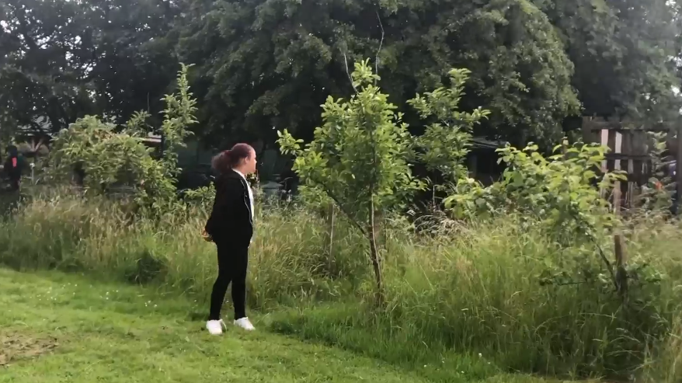

Compost Corner and Apple Trees

Slide 6
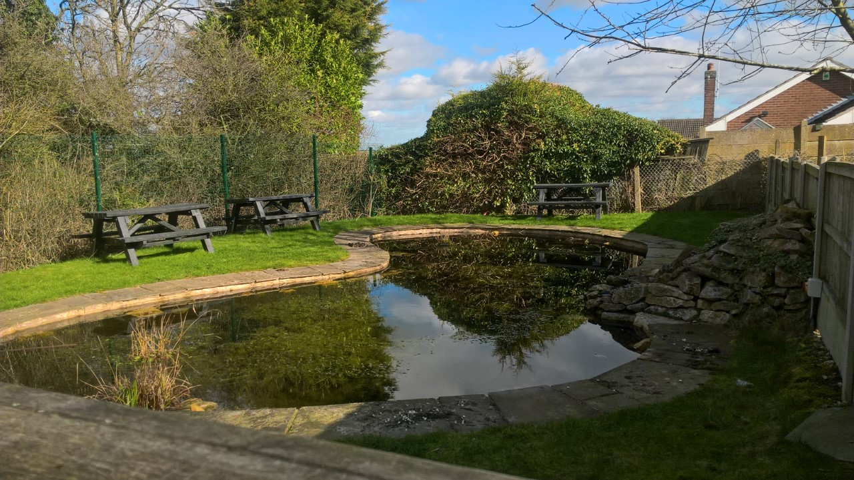

Slide 7
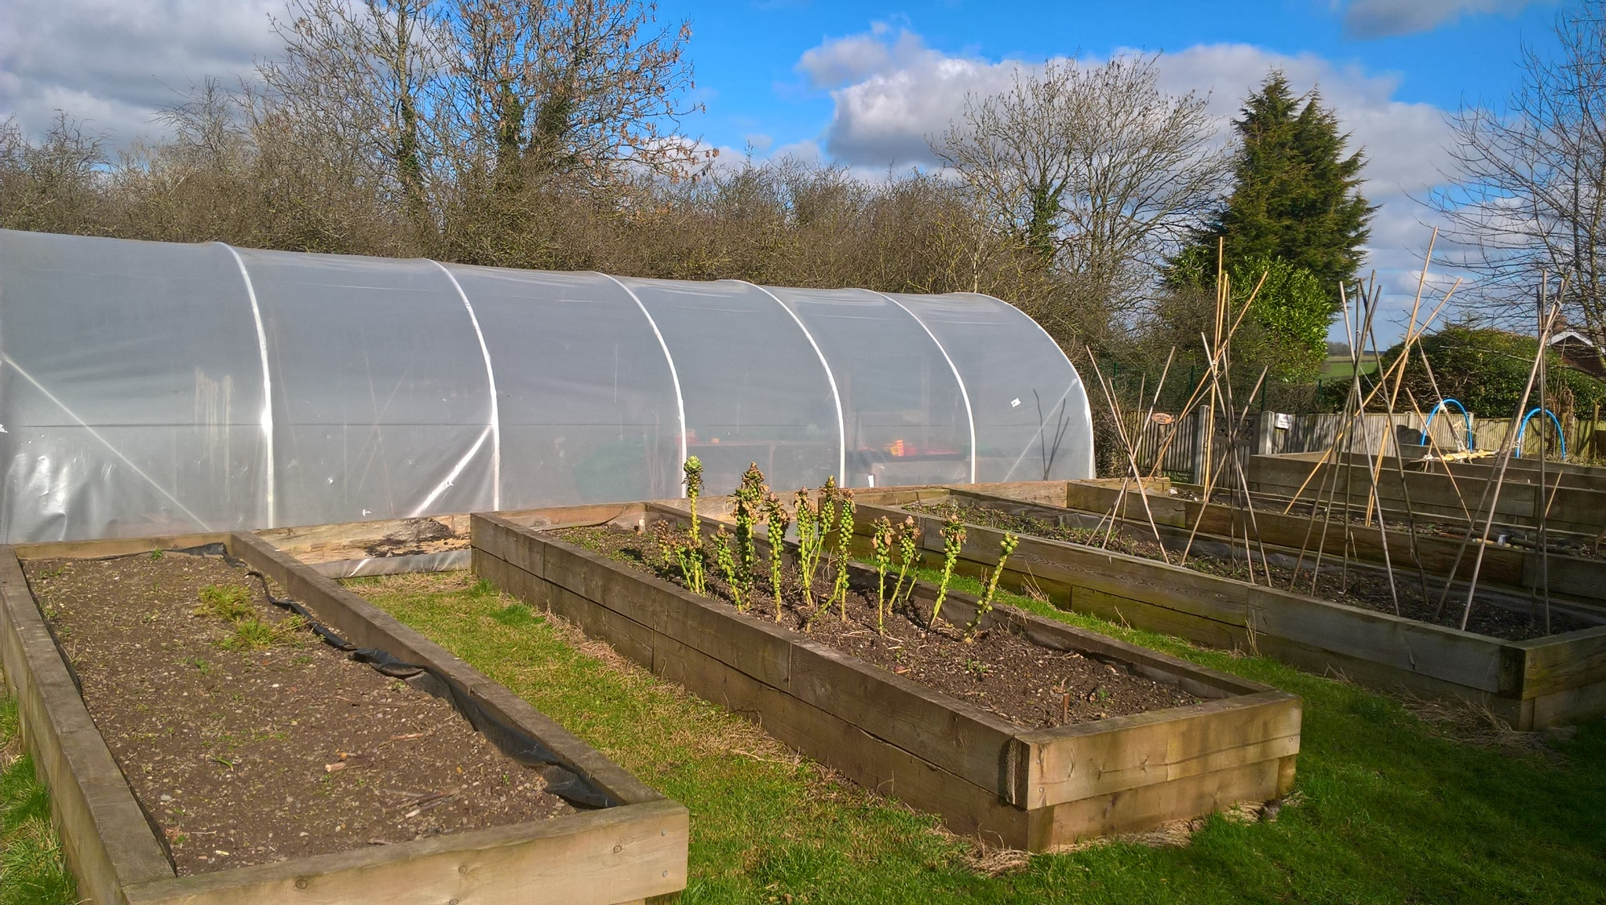

Slide 8
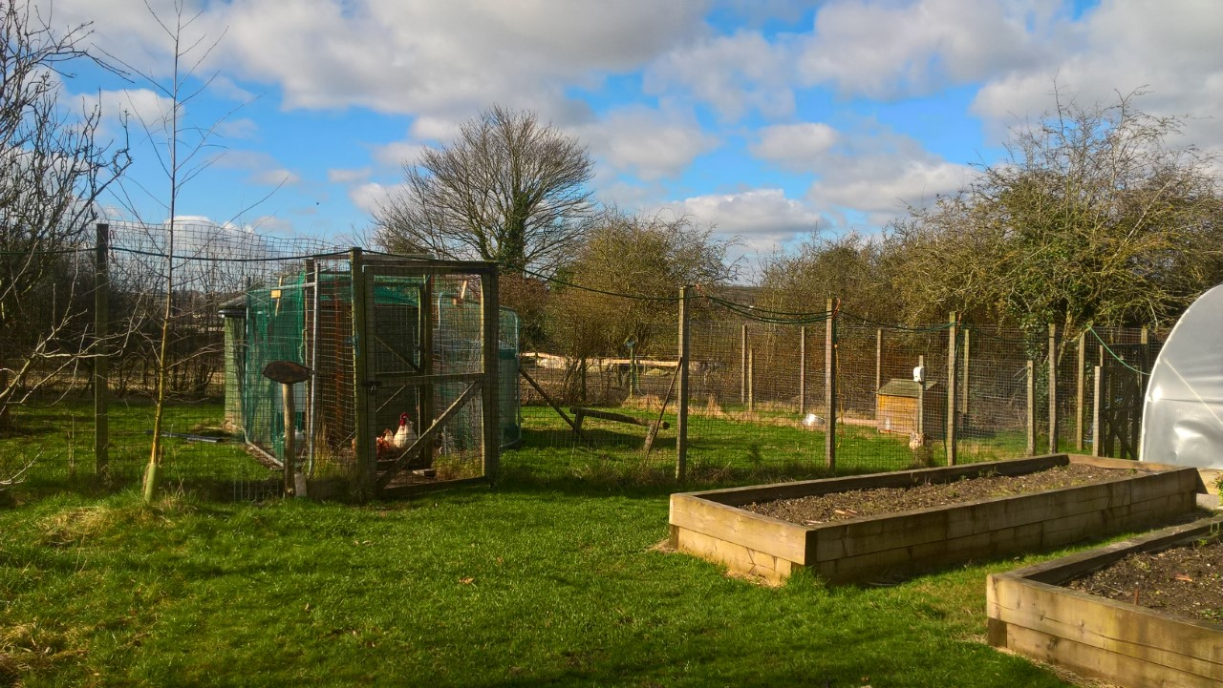

Slide 9
Organisation
Our Assistant Principal is the Forest School Lead. She has the Forest School qualification from NTU.
We employ a part time Forest School Teacher for three days each week.
Every class is taught Forest Schools for at least one hour and fifteen minutes per week, during class teachers’ PPA.

Slide 10
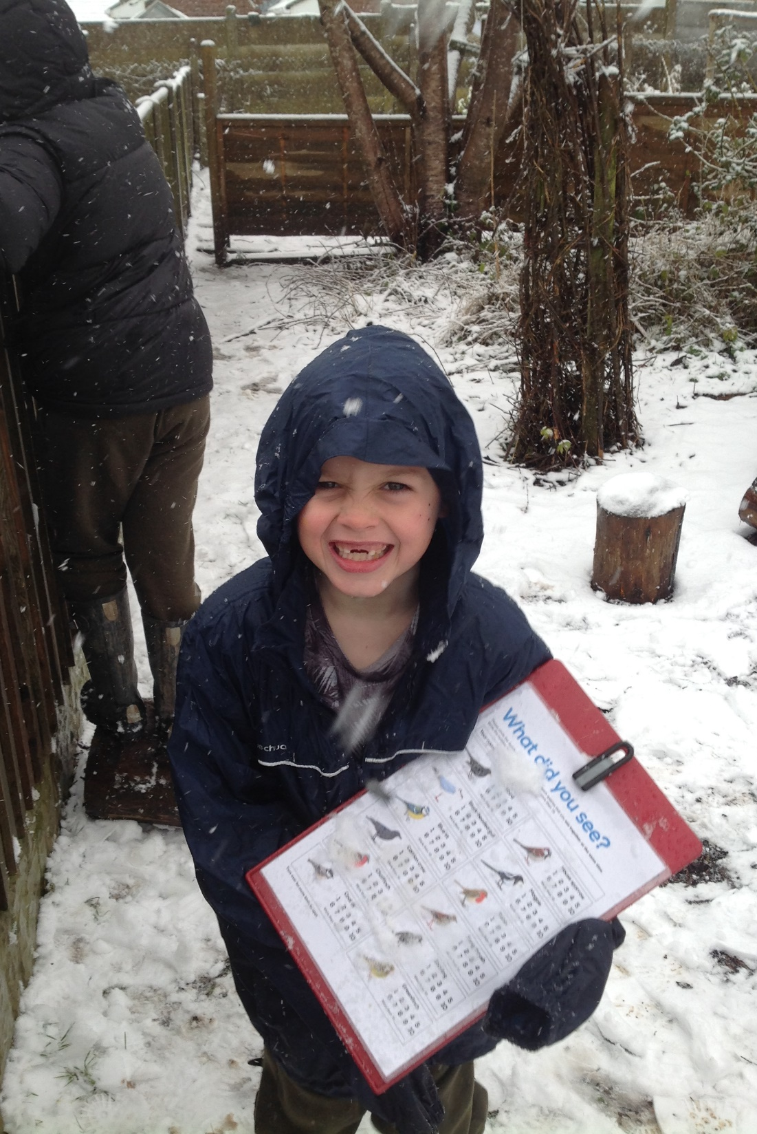
All children must wear suitable clothing!

Slide 11
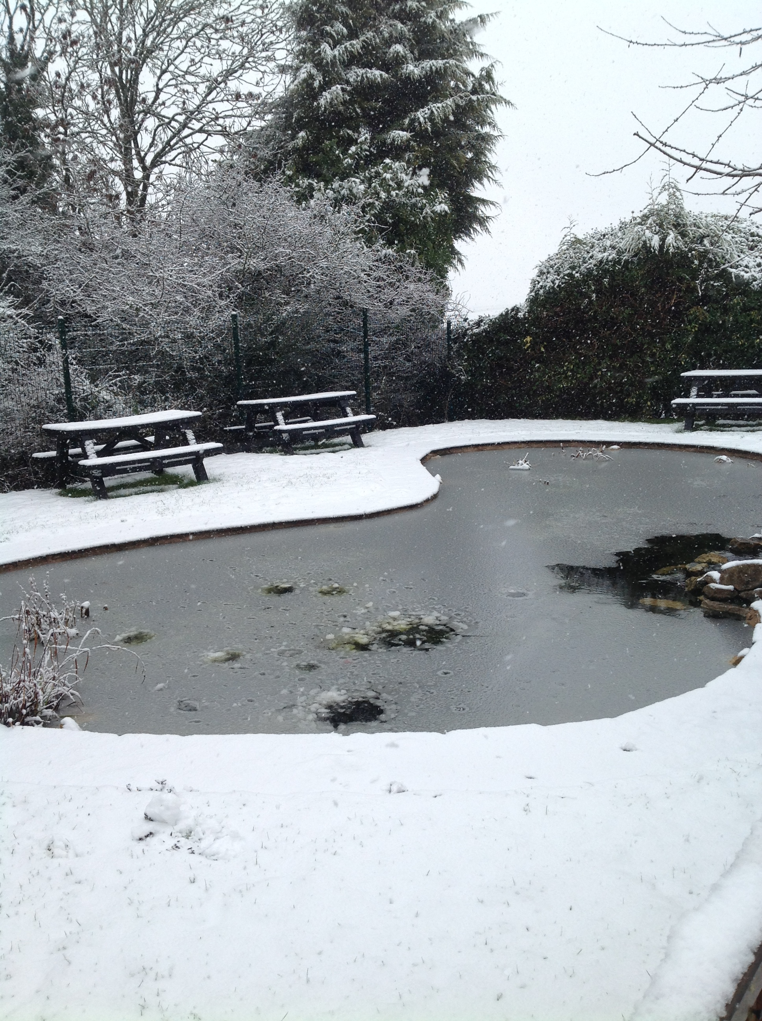

Slide 12
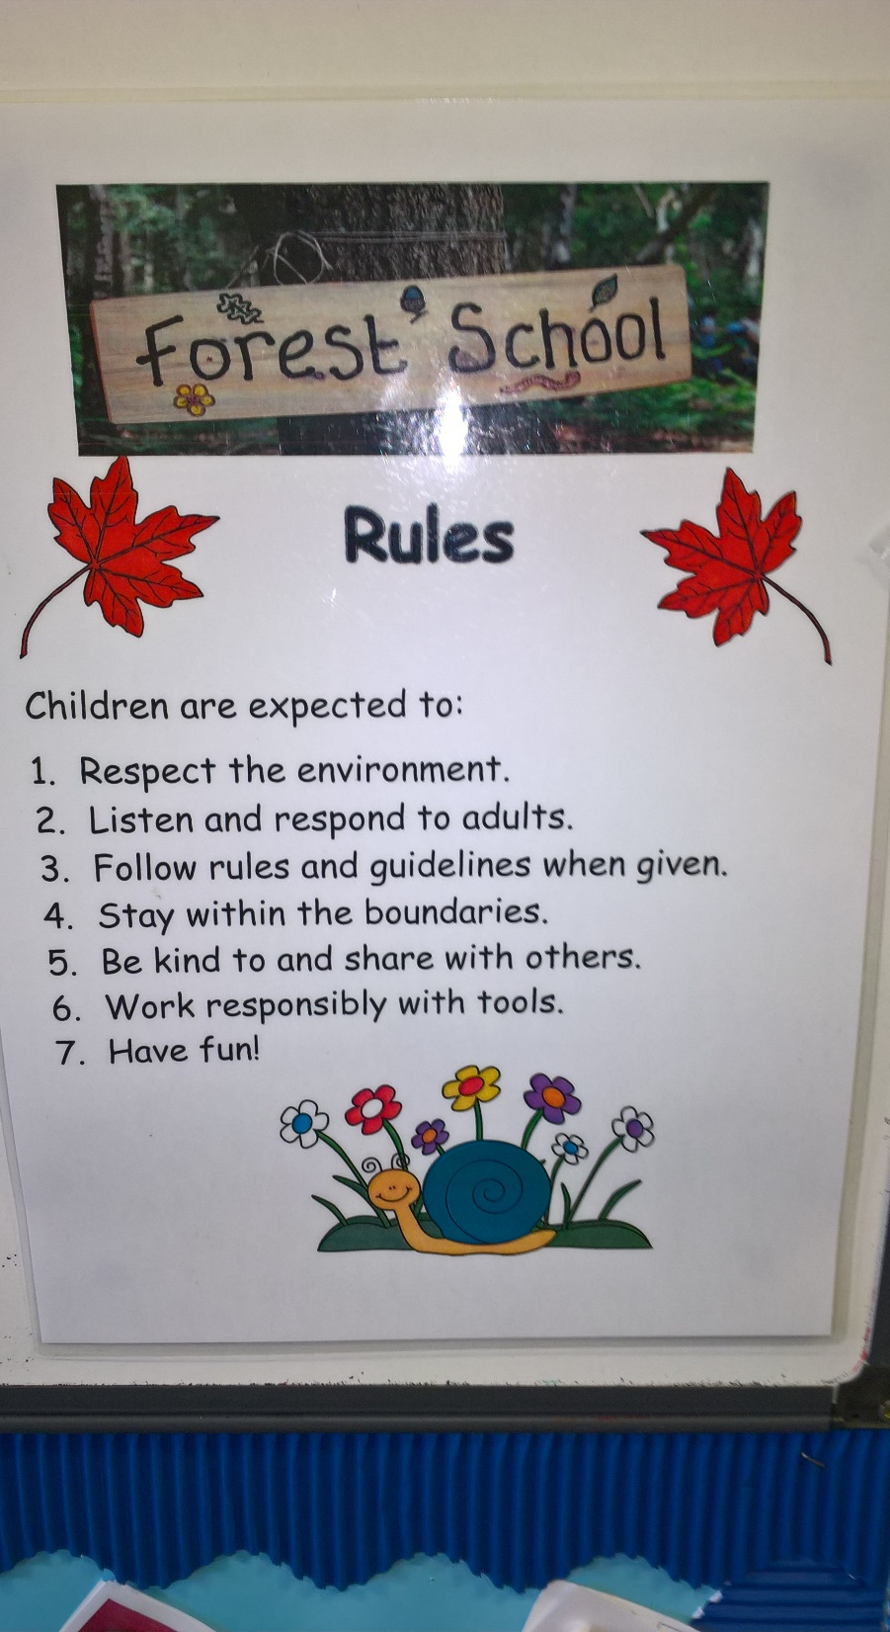
Forest School Rules

Slide 13
Our Curriculum

Slide 14
SMART Values
Successful People
Motivated
Active and Healthy
Ready to Learn
Teamwork

Slide 15
Our 5 Rs
Relationships
Resourcefulness
Resilience
Risk Taking
Reflective

Slide 16



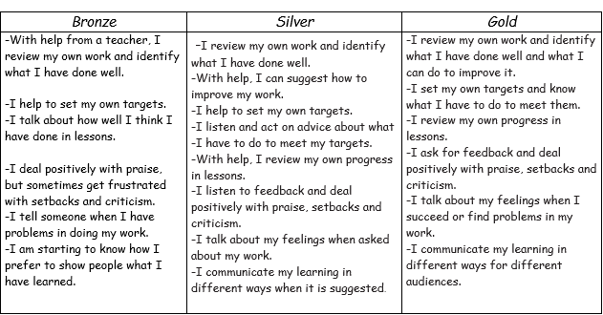
Skegby Junior Academy
Reflective

Slide 17
Blooms Taxonomy
Knowledge
Comprehension
Application
Analysis
Synthesis
Evaluation

Slide 18
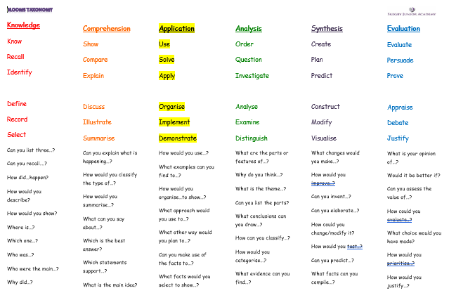

Slide 19
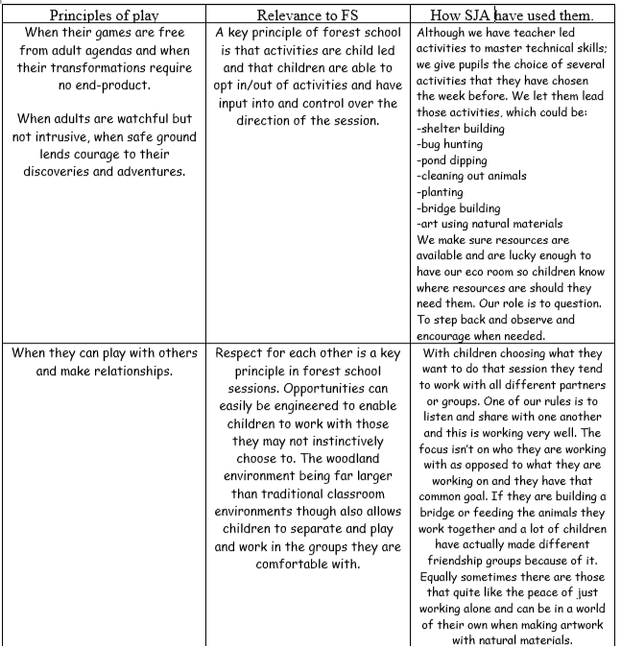
The ethos of Forest Schools is to allow children the time and space to develop skills, interest and understanding through a range of activities which provide practical, hands-on experiences in a natural environment.

Slide 20
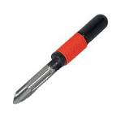
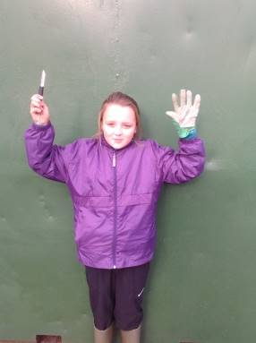
This is a potato peeler.
Tool Talk – Potato Peeler.
This is the handle.
These are the blades.
This is my workspace (bubble) I can use it when sitting down with my legs apart.
I use it with the blade facing away from me on the outside of the wood, the blade always moves away from me.
When not using it, I place it on the safety mat or put it back safely in the designated area.
If I need to walk with the potato peeler, I hold the blades in a gloved hand next to my leg with handles facing downwards.
When passing the blade, I hold the blade in a gloved hand and offer the handle to the other person.
Uses of a potato peeler: Whittling small soft sticks, peeling bark or cutting string.

Slide 21
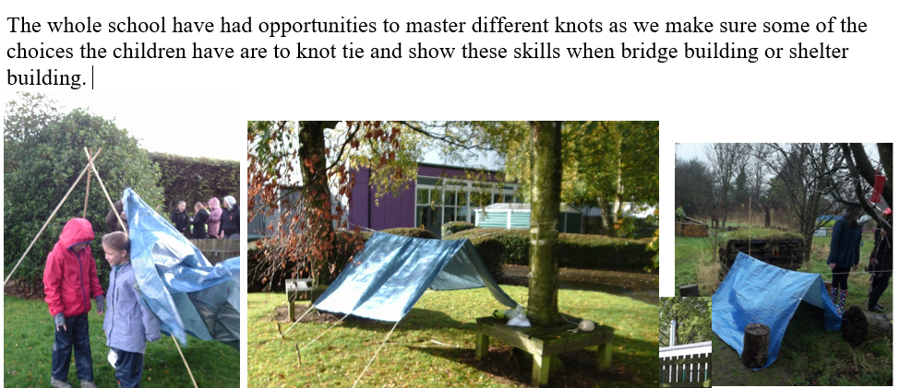
Activities in Forest School

Slide 22
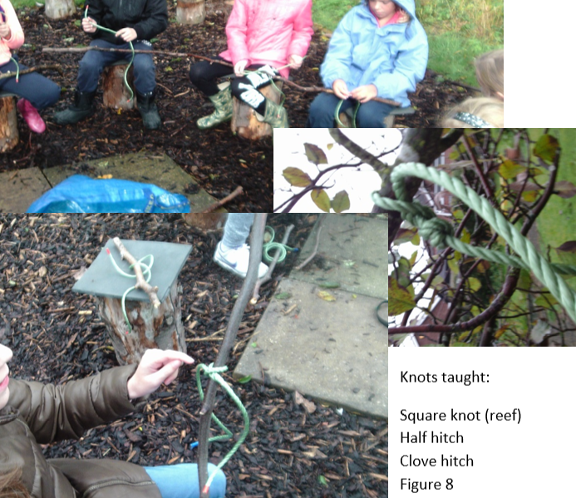

Slide 23
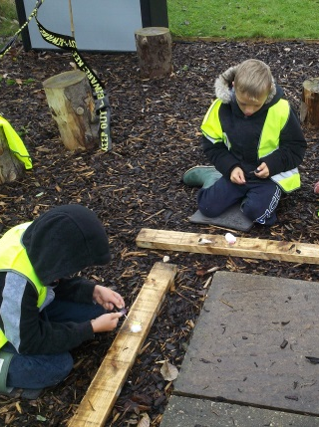
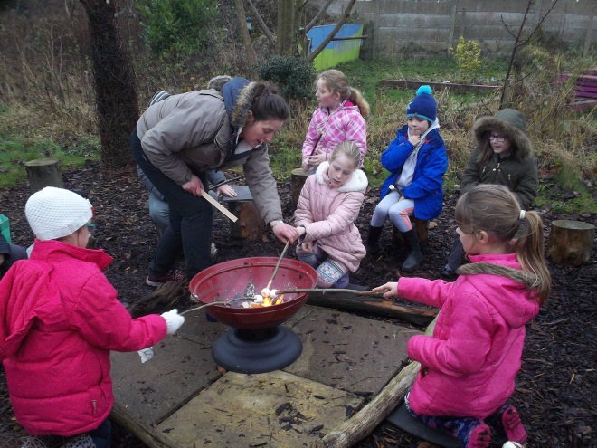
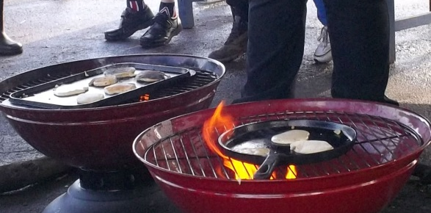

Slide 24
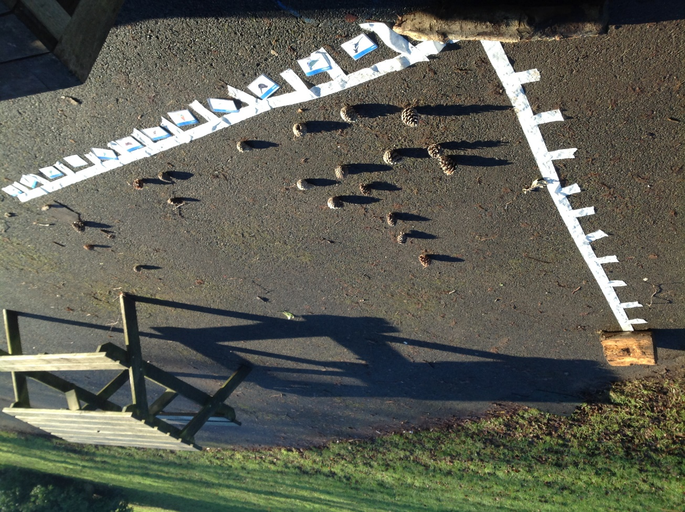
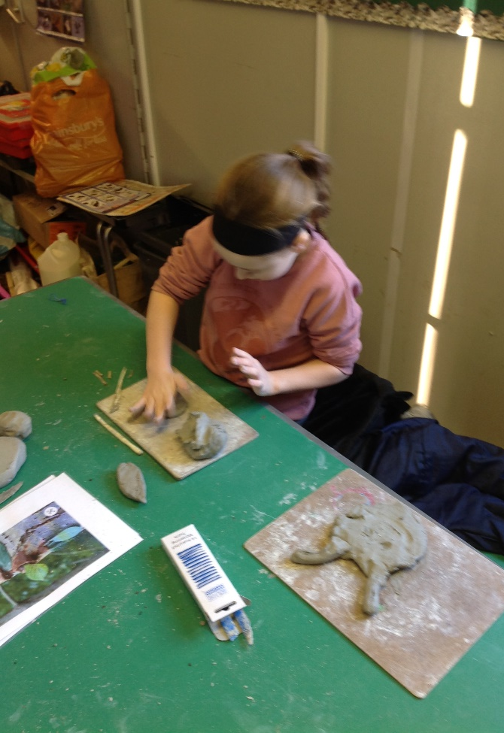
Curriculum Links

Slide 25
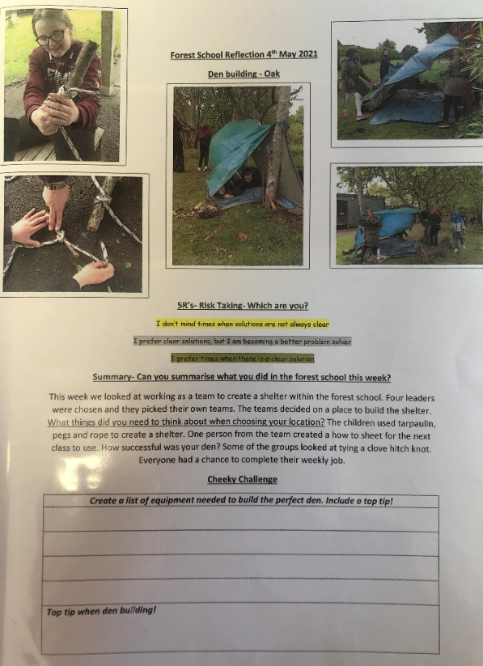

Slide 27
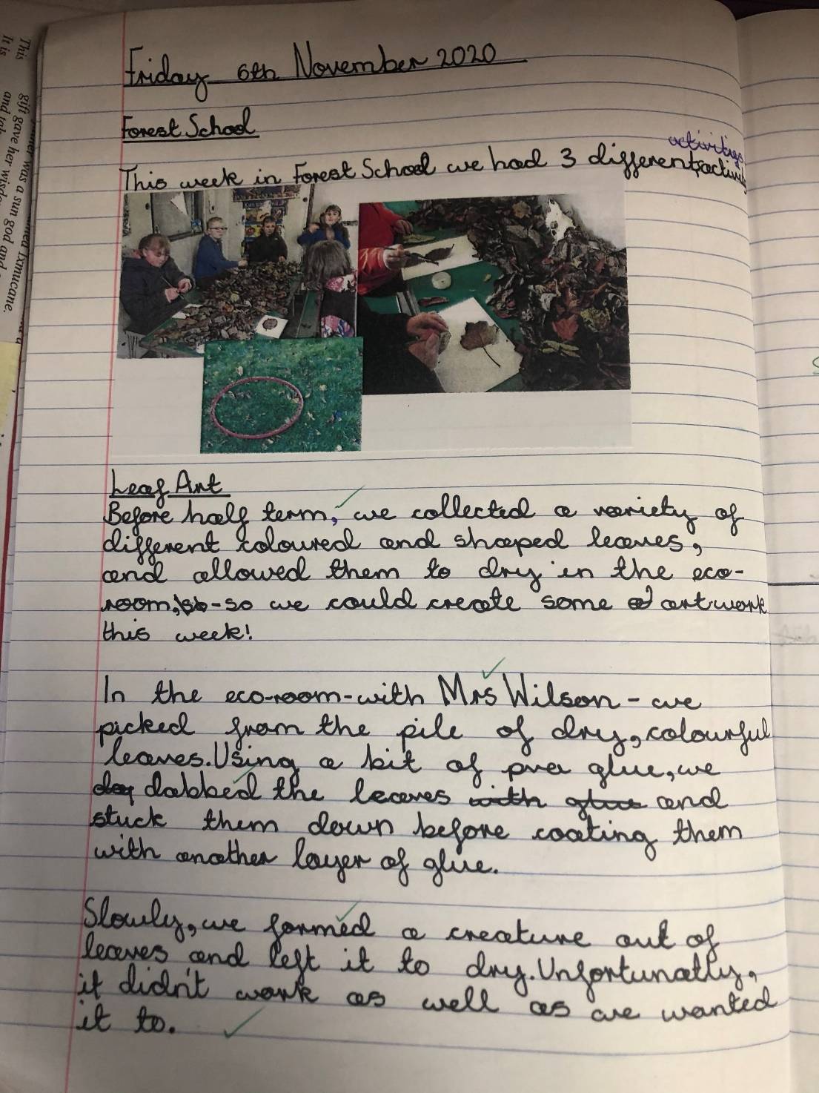

Slide 28
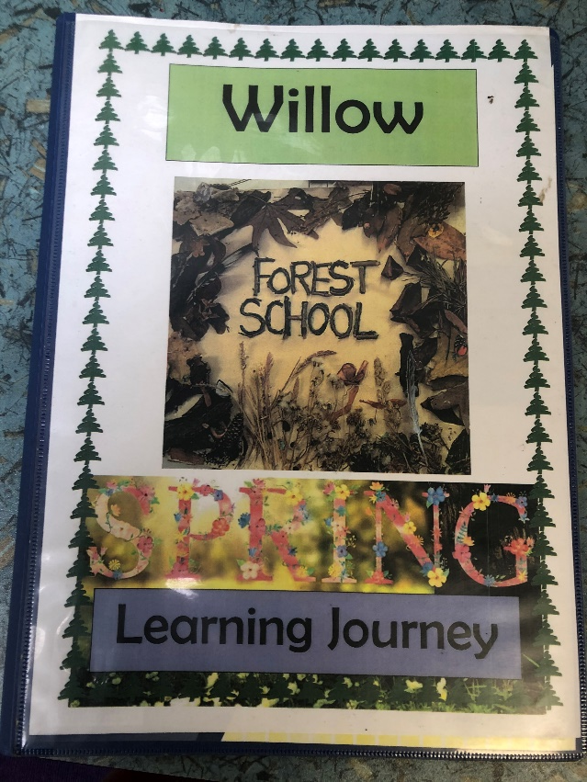
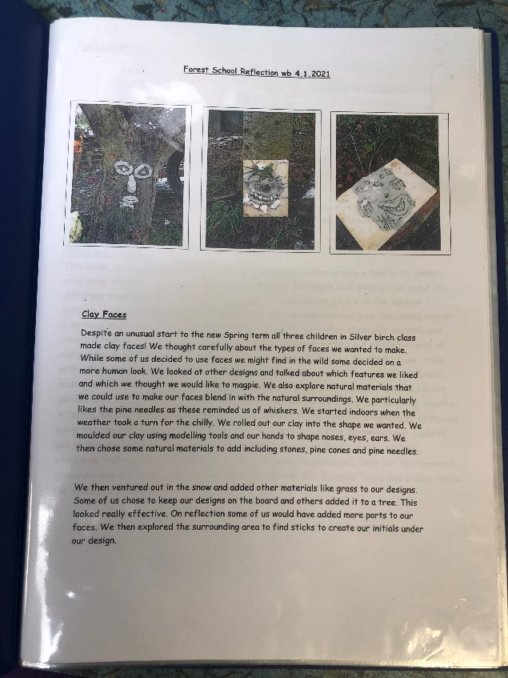
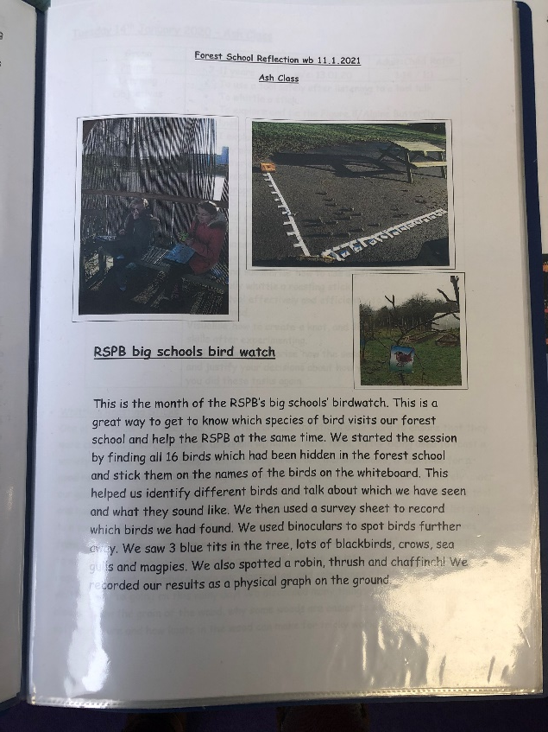
OUR A3 LEARNING JOURNEY

